Slide 1
Physical/ Physiological Changes |  | Method | Reference and data | p-value |  | Group
 | CHF
 | Heart failure |  | Roshanravan, B., Khatri, M., Robinson-Cohen, C., Levin, G., Patel, K. V., De Boer, I. H., ... & Kestenbaum, B. (2012). A prospective study of frailty in nephrology-referred patients with CKD. American Journal of Kidney Diseases, 60(6), 912-921.
 |  |  | Nonfrail vs. Frail
 |  |  | Heart Failure Prevalence (%): 12 vs. 30
 | Angina |  | Roshanravan, B., Khatri, M., Robinson-Cohen, C., Levin, G., Patel, K. V., De Boer, I. H., ... & Kestenbaum, B. (2012). A prospective study of frailty in nephrology-referred patients with CKD. American Journal of Kidney Diseases, 60(6), 912-921.
 |  |  | Nonfrail vs. Frail
 |  |  | Angina Prevalence(%): 22 vs. 34
 | Brain wave |  | Chao, C.-T., Lai, H.-J., Tsai, H.-B., Yang, S.-Y., &Huang, J.-W. (2017). Frail phenotype is associated with distinct quantitative electroencephalographic findings among end-stage renal disease patients: an observational study. BMC Geriatrics, 17(1), 277.
 |  |  | moderate to severe frailty v. none to mild frailty
 |  |  | DAR (global): 283 ± 679 vs. 2971 ± 4859 DARs (left frontal): 135 ± 250 vs. 3073 ± 4702 left TO: 197 ± 318 vs. 3708 ± 6398, Central: 55 ± 96 vs. 1773 ± 3262, right TO: 187 ± 261 vs. 4400 ± 7763, global DTABR: 191 ± 469 vs. 1781 ± 2793 DTABRs (left frontal): 86 ± 158 vs. 1680 ± 2388 left TO: 130 ± 210 vs. 1884 ± 2828 Central: 39 ± 65 vs. 1132 ± 1957 right TO DTABR: 126 ± 178 vs. 2960 ± | DAR (gloibal): .02 DARs (left frontal): .01 Central: .03 Right TO: .02 Global DTABR: .02 DTABR (left frontal) <.01 Left TO: .01 Central: .02 Right TO DTABR: .03 Overall p=.02
 | Diabetes |  | Roshanravan, B., Khatri, M., Robinson-Cohen, C., Levin, G., Patel, K. V., De Boer, I. H., ... & Kestenbaum, B. (2012). A prospective study of frailty in nephrology-referred patients with CKD. American Journal of Kidney Diseases, 60(6), 912-921.
 |  |  | Nonfrial vs. Frail
 |  |  | Diabetes Prevalence (%): 49 vs. 64
 | Obese |  | Roshanravan, B., Khatri, M., Robinson-Cohen, C., Levin, G., Patel, K. V., De Boer, I. H., ... & Kestenbaum, B. (2012). A prospective study of frailty in nephrology-referred patients with CKD. American Journal of Kidney Diseases, 60(6), 912-921.
 |  |  | Nonfrail vs. Frail
 |  |  | Obese (%): 50 vs. 64
 | Disability |  | Roshanravan, B., Khatri, M., Robinson-Cohen, C., Levin, G., Patel, K. V., De Boer, I. H., ... & Kestenbaum, B. (2012). A prospective study of frailty in nephrology-referred patients with CKD. American Journal of Kidney Diseases, 60(6), 912-921.
 |  |  | Nonfrail vs. Frail
 |  |  | ADL (%): 5 vs. 15 IADL (%): 28 vs. 60 Mobility Disability (%): 18 vs. 40 | ADL: .009 IADL: < .001 Mobility Disability: .001
 | Cerebrovascular disease |  | McAdams-DeMarco, M. A., Tan, J., Salter, M. L., Gross, A., Meoni, L. A., Jaar, B. G., ... & Sozio, S. M. (2015). Frailty and cognitive function in incident hemodialysis patients. Clinical Journal of the American Society of Nephrology, 10(12), 2181-2189.
 |  |  | Nonfrail vs. Intermediate frail vs. Frail
 |  |  | Cerebrovascular disease: 12.0 vs. 22.1 vs. 26.4 | Cerebrovascular disease: .03
 | HTN, CVA, LVD, PVD, smoking, IDH, serum creatinine, and hemoglobin |  | (1) RR 1.1-1.5 |  |  | (1) Yadla, John, & Mummadi, 2017

Slide 2
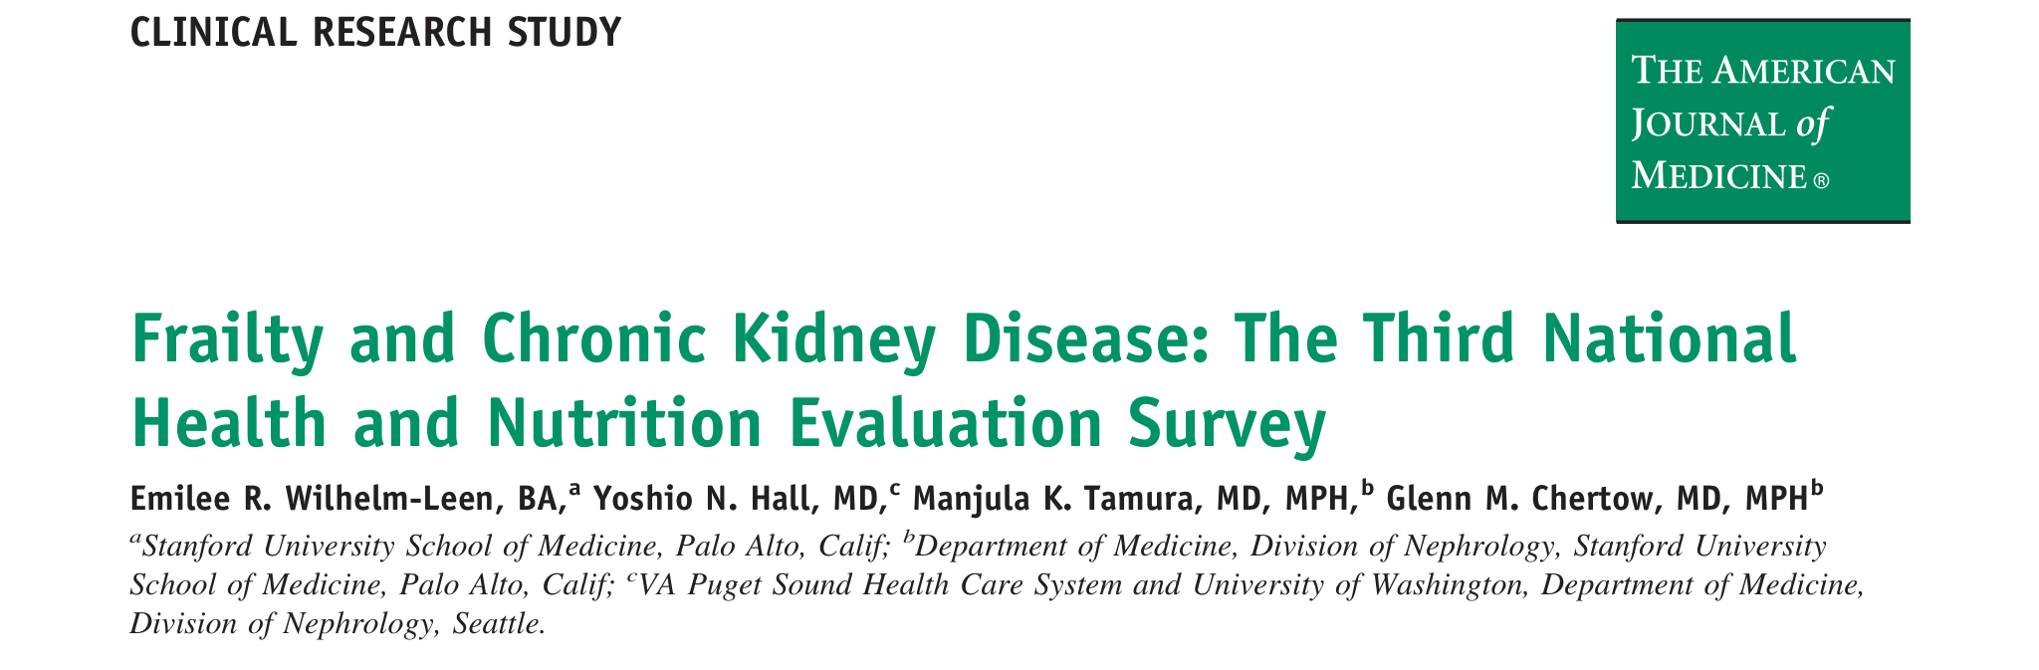
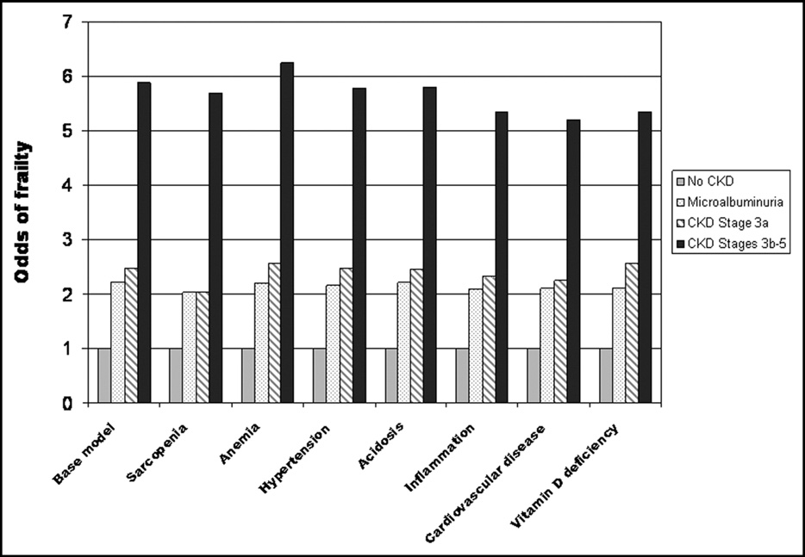
Wilhelm-Leen, E. R., Hall, Y. N., Tamura, M. K., & Chertow, G. M. (2009). Frailty and chronic kidney disease: the third national health and nutrition evaluation survey. The American journal of medicine, 122(7), 664-671.

Slide 3
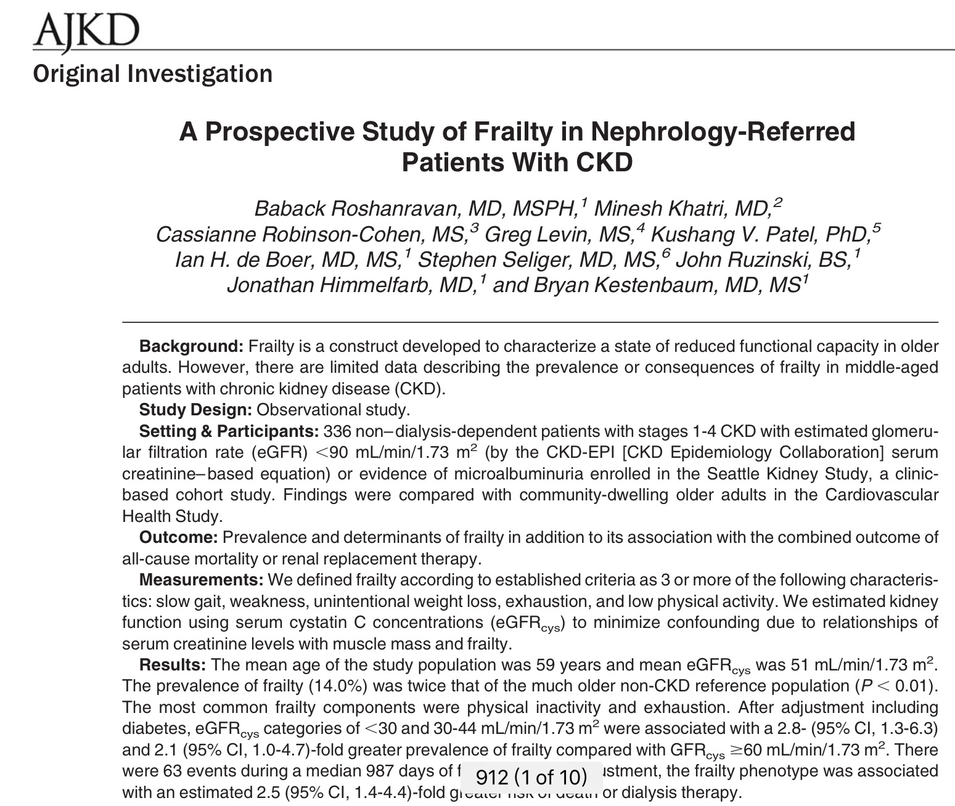
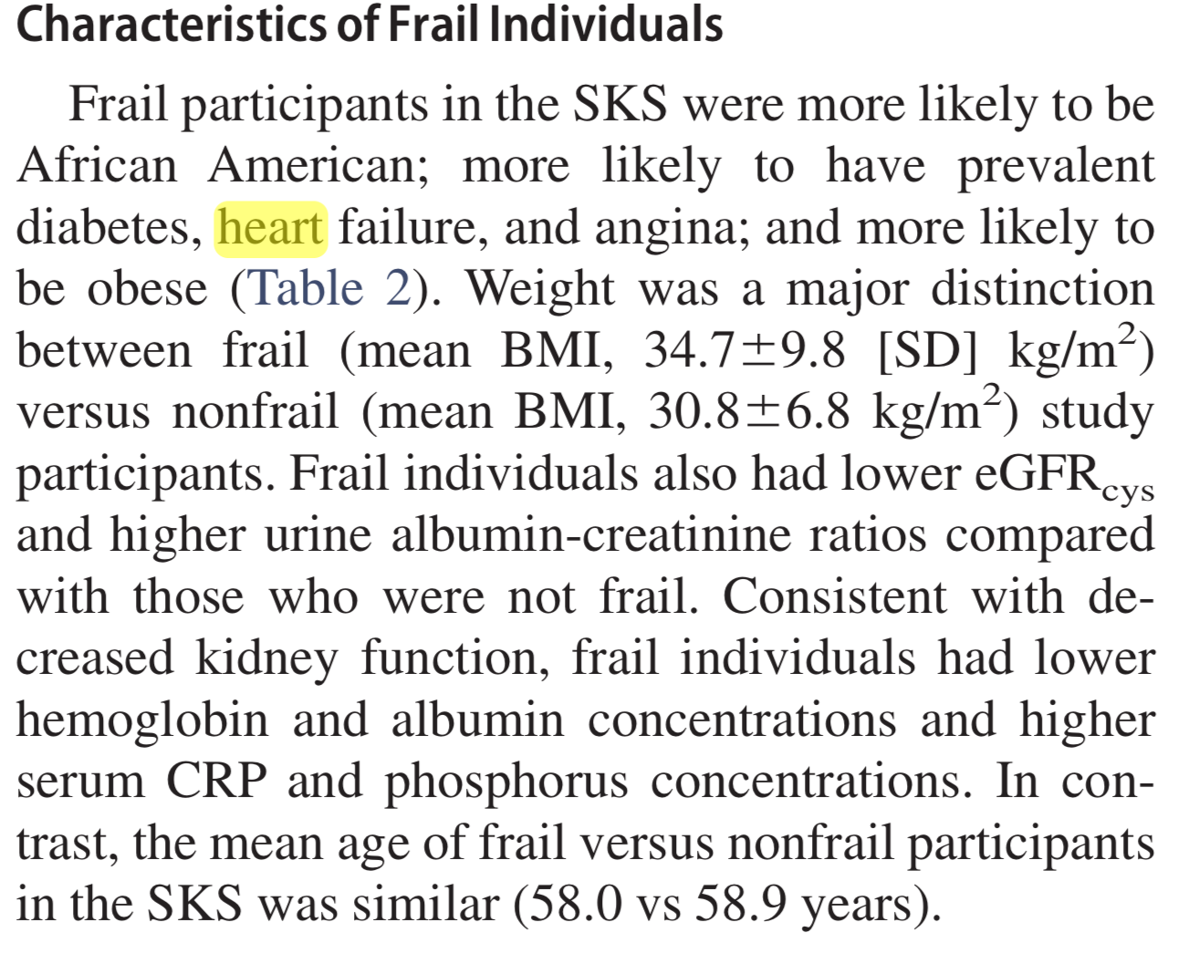
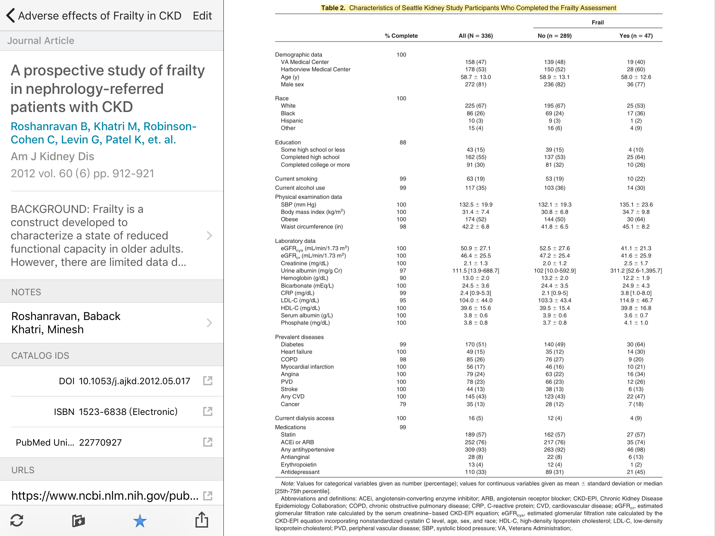

Roshanravan, B., Khatri, M., Robinson-Cohen, C., Levin, G., Patel, K. V., De Boer, I. H., ... & Kestenbaum, B. (2012). A prospective study of frailty in nephrology-referred patients with CKD. American Journal of Kidney Diseases, 60(6), 912-921.

Slide 4
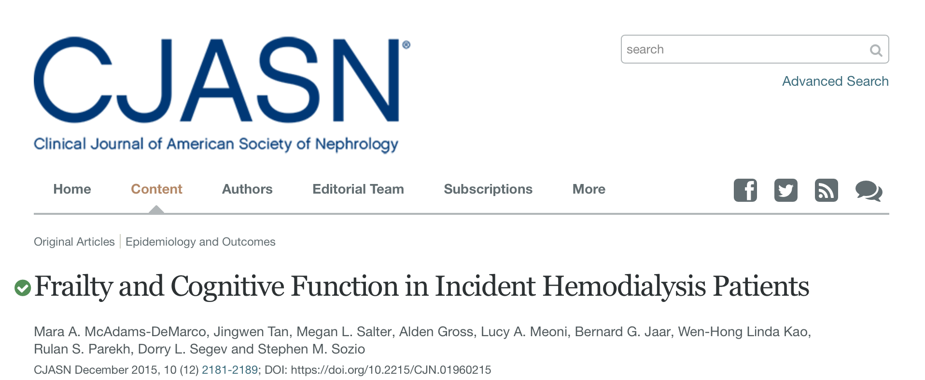
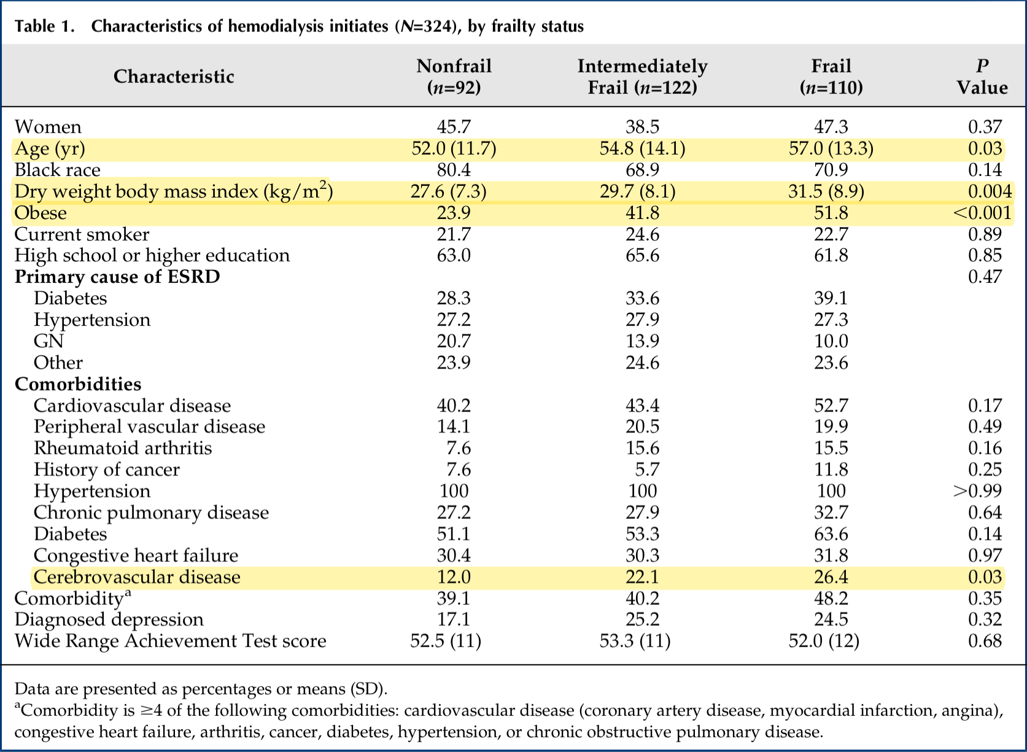
McAdams-DeMarco, M. A., Tan, J., Salter, M. L., Gross, A., Meoni, L. A., Jaar, B. G., ... & Sozio, S. M. (2015). Frailty and cognitive function in incident hemodialysis patients. Clinical Journal of the American Society of Nephrology, 10(12), 2181-2189.

Slide 5
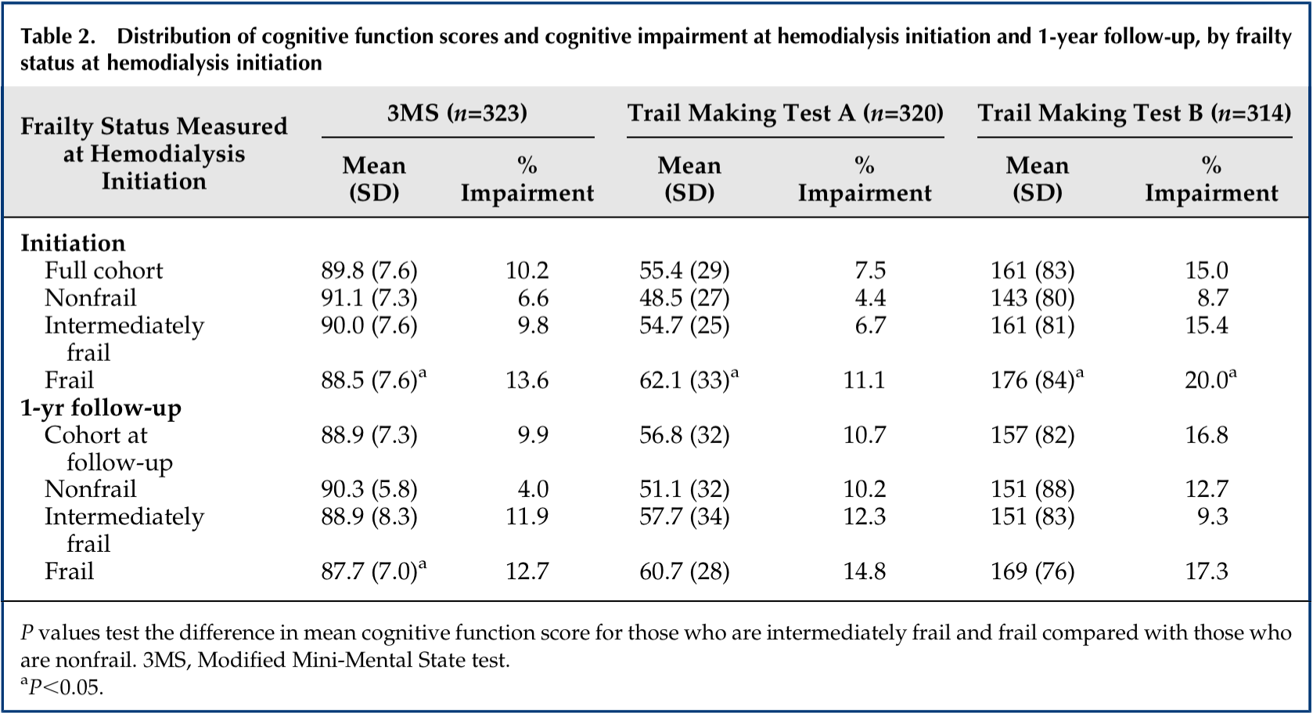
No significance
McAdams-DeMarco, M. A., Tan, J., Salter, M. L., Gross, A., Meoni, L. A., Jaar, B. G., ... & Sozio, S. M. (2015). Frailty and cognitive function in incident hemodialysis patients. Clinical Journal of the American Society of Nephrology, 10(12), 2181-2189.

